Slide 1
CS 205
Artificial Intelligence

Slide 2
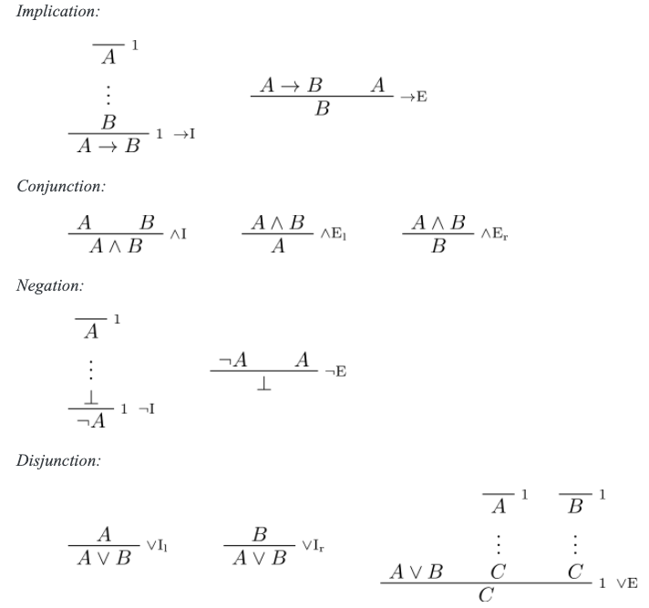
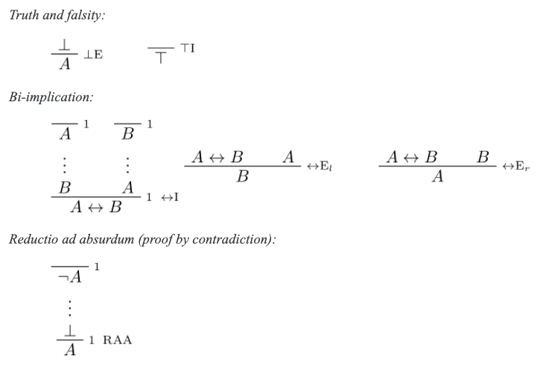


Review: Natural Deduction.
DOWNLOAD:
https://drive.google.com/file/d/1EXKODkS4ovUHDes7YfyrFOwTFIHcpr1g/view?usp=sharing
Source: https://leanprover.github.io/logic_and_proof/natural_deduction_for_propositional_logic.html

Slide 3

Practice Problems
A→C from 𝐴→𝐵 and 𝐵→𝐶:
A→C

Slide 4
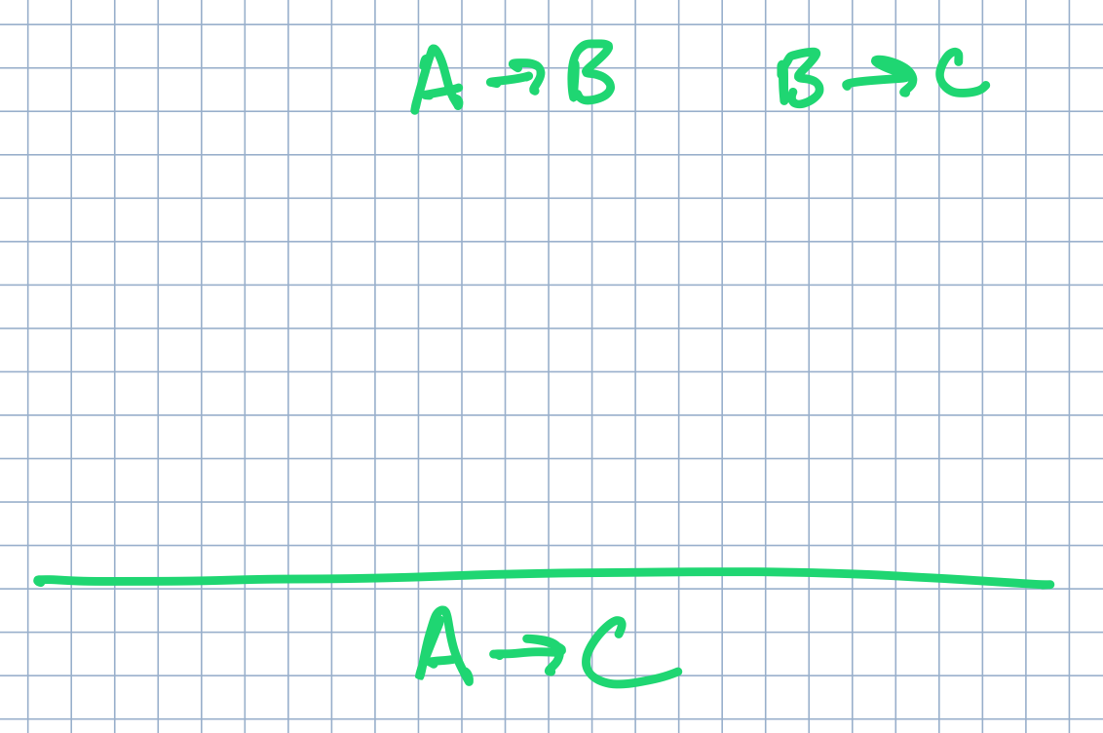
Practice Problems
A→C from 𝐴→𝐵 and 𝐵→𝐶:
A→C

Slide 5
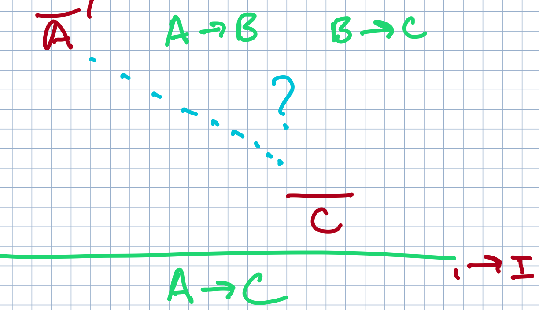
Practice Problems
A→C from 𝐴→𝐵 and 𝐵→𝐶:
A→C

Slide 6
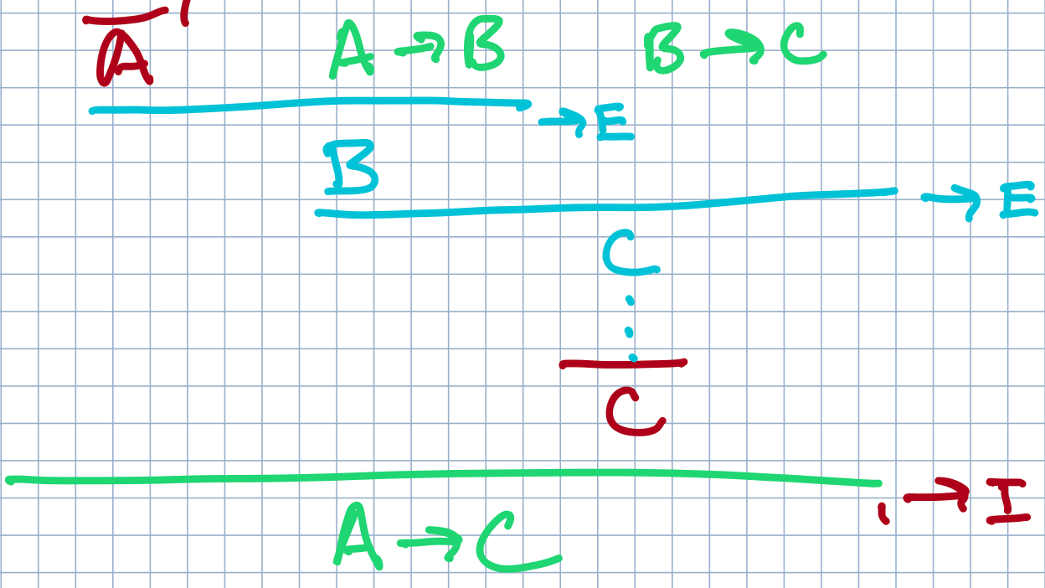
Practice Problems
A→C from 𝐴→𝐵 and 𝐵→𝐶:
A→C

Slide 7
Practice Problems
(𝐴→𝐵)∧(𝐵→𝐶)→(𝐴→𝐶)

Slide 8
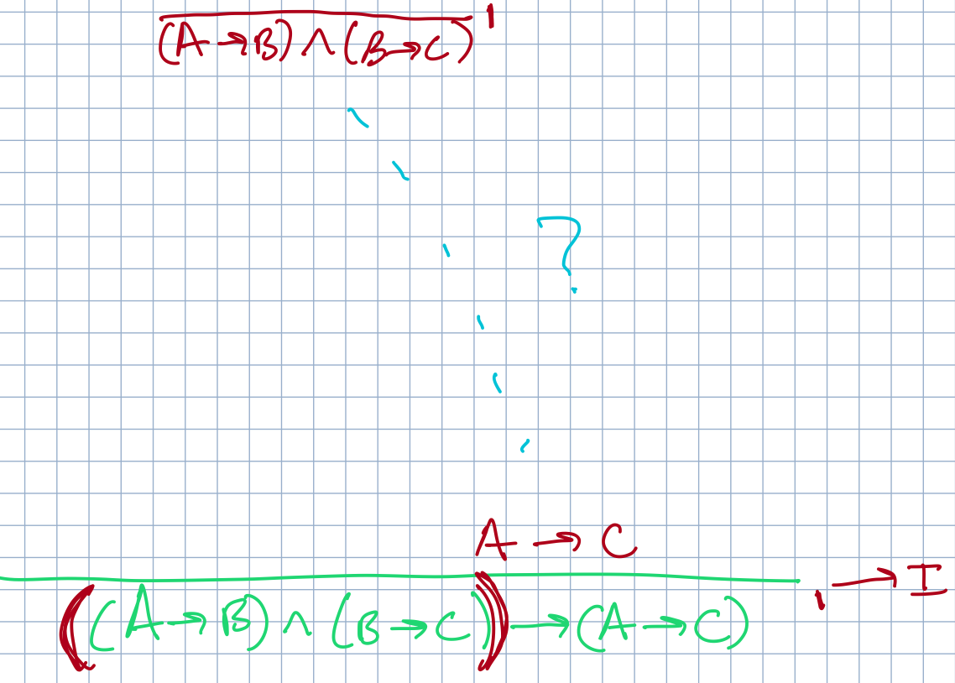
Practice Problems
(𝐴→𝐵)∧(𝐵→𝐶)→(𝐴→𝐶)

Slide 9
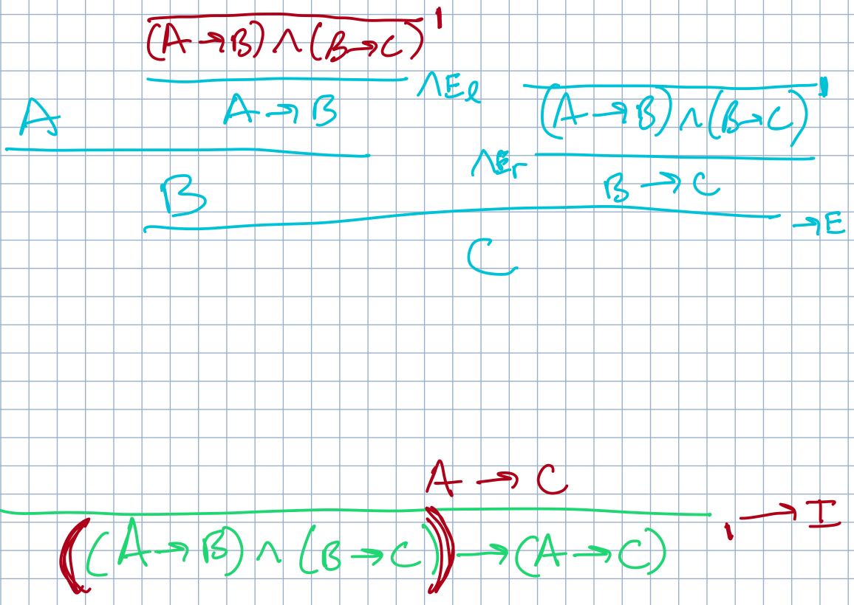
Practice Problems
(𝐴→𝐵)∧(𝐵→𝐶)→(𝐴→𝐶)

Slide 10
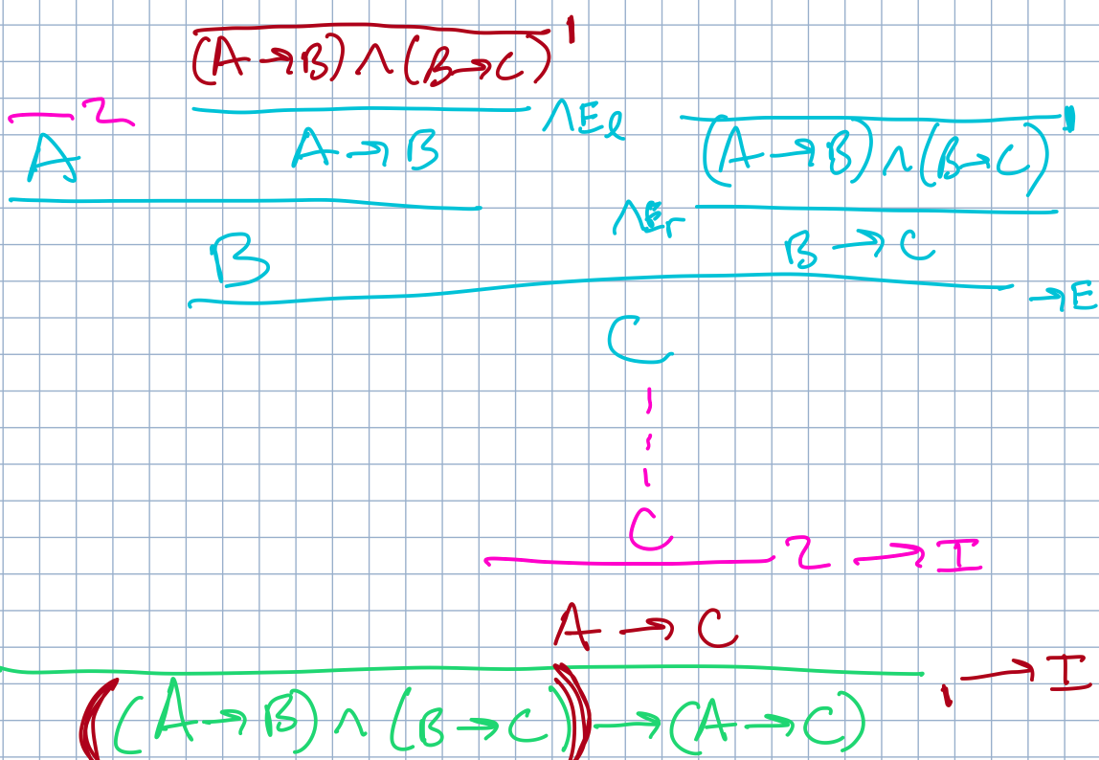
Practice Problems
(𝐴→𝐵)∧(𝐵→𝐶)→(𝐴→𝐶)

Slide 11
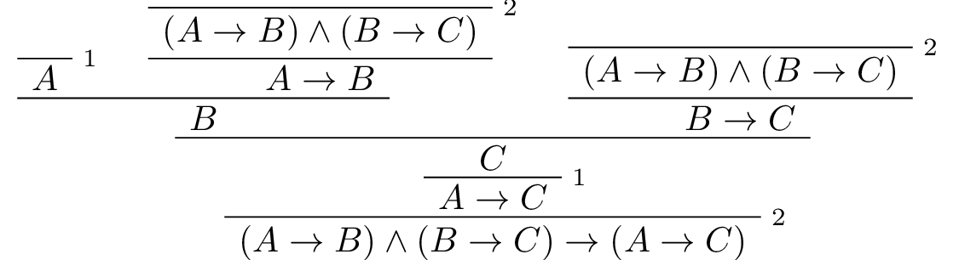

See the difference?
These hypotheses do not need to be proven! They remain underived.
(𝐴→𝐵)∧(𝐵→𝐶)→(𝐴→𝐶)
A→C from 𝐴→𝐵 and 𝐵→𝐶:
A→C
Yet, the core sub-structure of the proof remains!
Every hypothesis-style proposition can be trivially transformed into a conditional in this way.
Here, the hypotheses are made explicit as conditionals.

Slide 12
Practice Problems
¬¬𝐴→𝐴
[ read: ¬(¬𝐴)→𝐴 ]

Slide 13
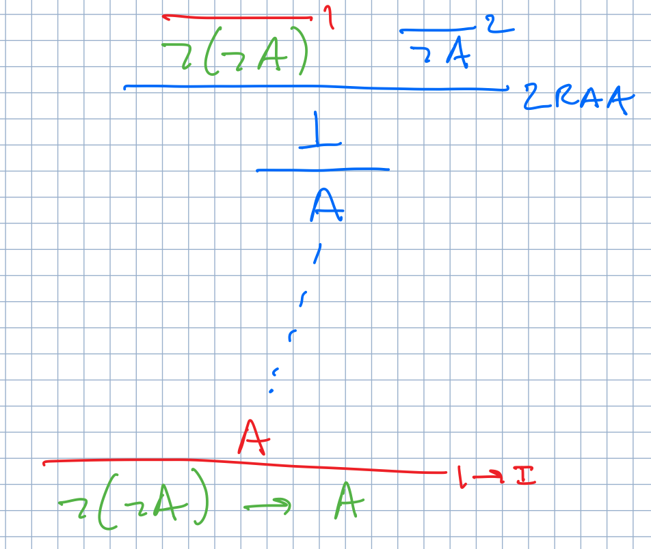
Practice Problems
¬¬𝐴→𝐴
[ read: ¬(¬𝐴)→𝐴 ]

Slide 14
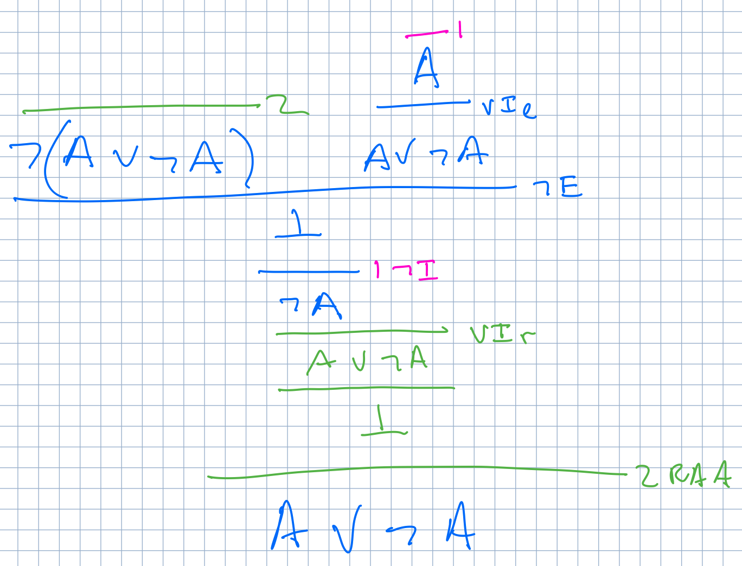
Practice Problems
𝐴∨¬𝐴
(aka Law of the Excluded Middle, LEM)

Slide 15
Practice Problems
DeMorgan's Laws: Breakout into small teams, solve one. Form into a larger group (~1/4 class size). Negotiate best answer to offer up.
1. ¬𝐴∧¬𝐵 → ¬(𝐴∨𝐵) 3. ¬(𝐴∨𝐵) → ¬𝐴∧¬𝐵
2. ¬(𝐴∧𝐵) → ¬𝐴∨¬𝐵 4. ¬𝐴∨¬𝐵 → ¬(𝐴∧𝐵)
Q: Which is the "hardest" one to prove?

Slide 16
First order logic
Entailment vs Inference
Propositions and Predicates
Quantification: forall, exists
Soundness and Completeness
Functions and Skolem terms
Let's take a look at Prof Eamonn's slides... [to be continued].

Slide 17
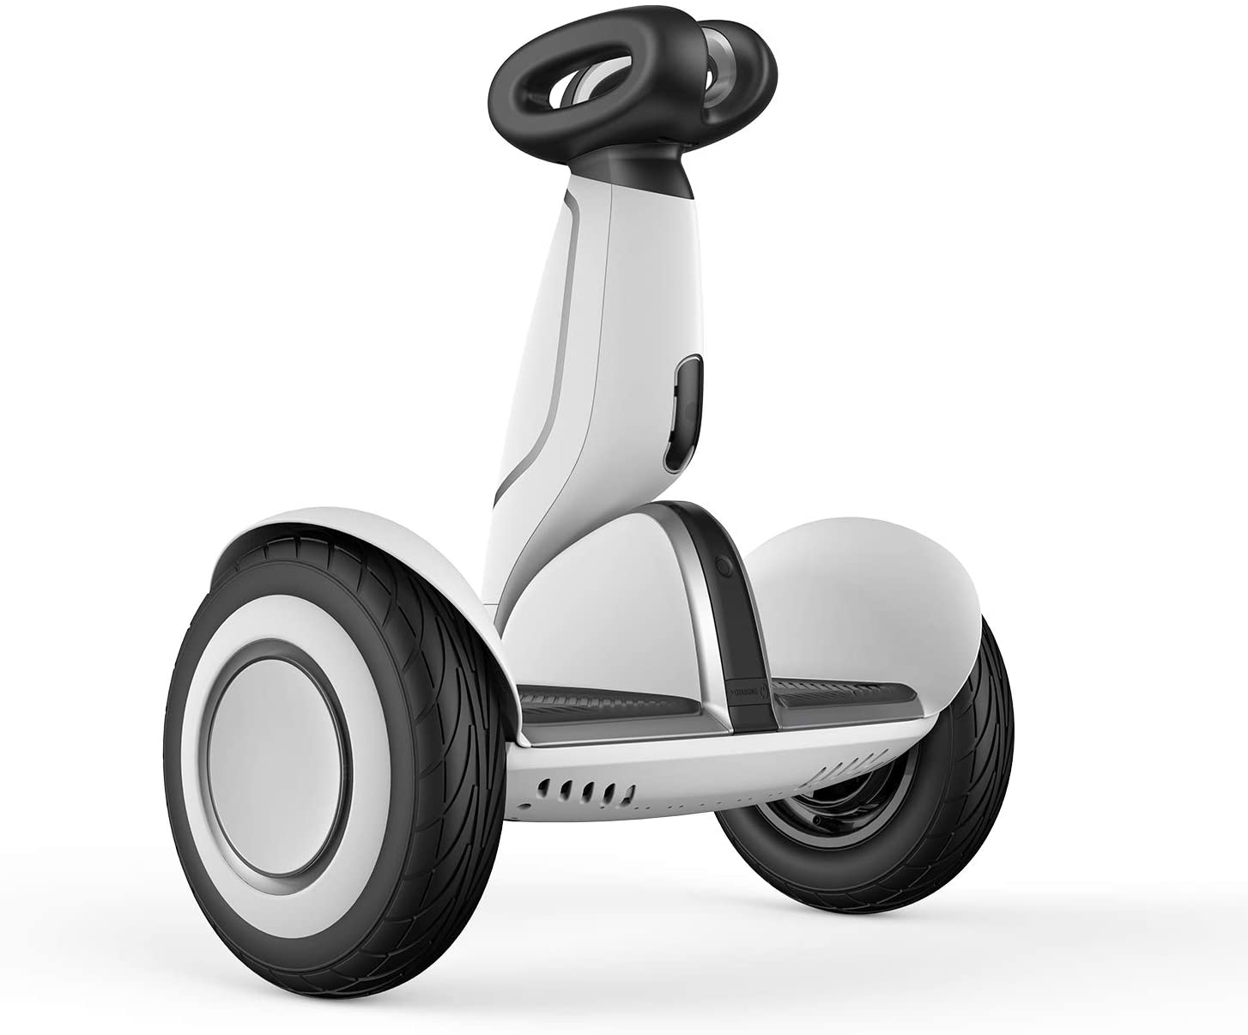
Seque ... paper presentation time!

Slide 18
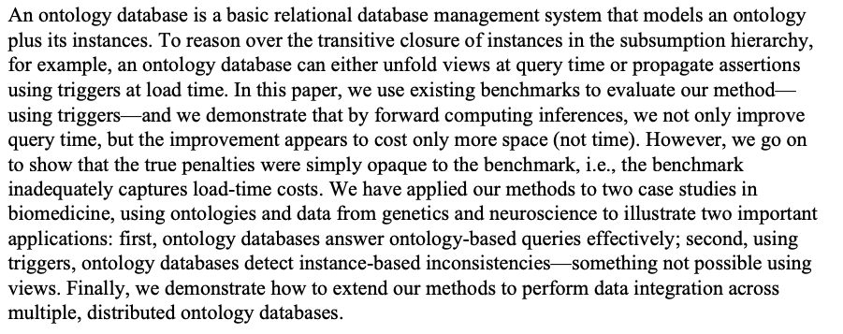
Paper: "Ontology Databases" -by Paea LePendu
"Using ontology databases for scalable query answering, inconsistency detection, and data integration." Paea LePendu and Dejing Dou, 2011. J Intell Inf Syst.

Slide 19
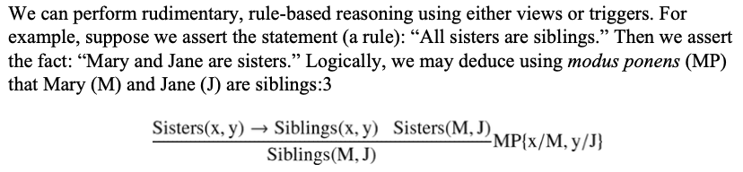
Paper: "Ontology Databases" -by Paea LePendu
https://www.ncbi.nlm.nih.gov/pmc/articles/PMC3230227/
The Basic Idea:
CREATE VIEW siblings(x,y) as
SELECT x,y FROM a_siblings
UNION
SELECT x,y FROM sisters
CREATE TRIGGER subproperty_sisters_siblings
ON INSERT (x,y) INTO sisters
FIRST INSERT (x,y) INTO siblings

Slide 20
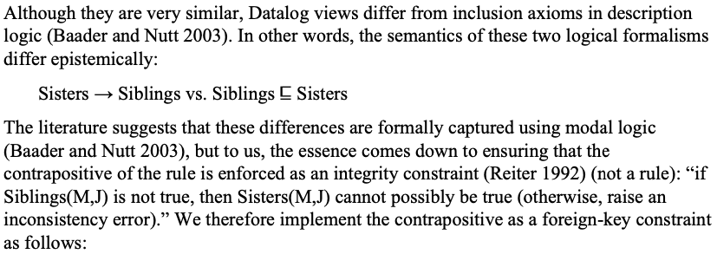
Paper: "Ontology Databases" -by Paea LePendu
https://www.ncbi.nlm.nih.gov/pmc/articles/PMC3230227/
Subsumption:

Slide 21
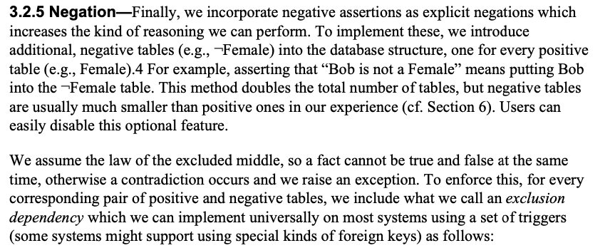
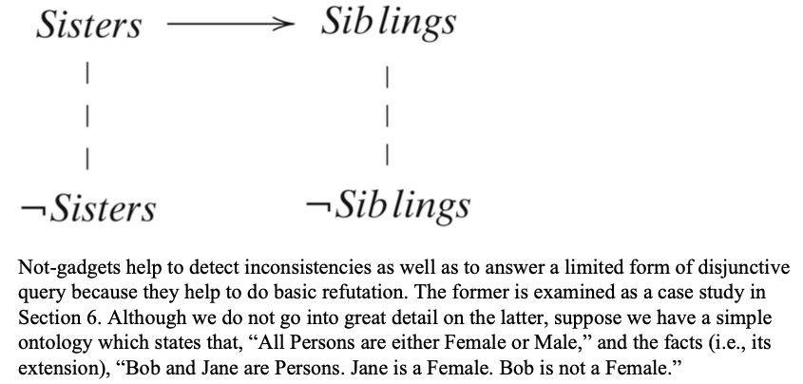
Paper: "Ontology Databases" -by Paea LePendu
https://www.ncbi.nlm.nih.gov/pmc/articles/PMC3230227/
Not-gadgets:
First order logic!
Aha! You know this!

Slide 22
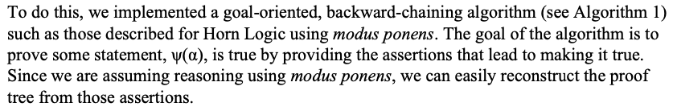
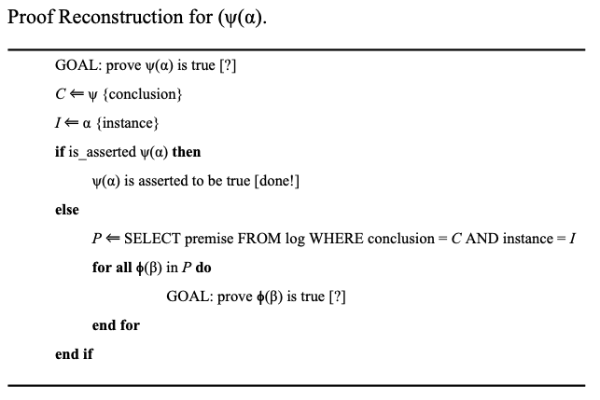
Paper: "Ontology Databases" -by Paea LePendu
https://www.ncbi.nlm.nih.gov/pmc/articles/PMC3230227/
Proof Reconstruction Algorithm:
Horn Logic?
Modus Ponens!
Backward Chaining!

